Slide 1
IAS Course Guidance
Alhassan Abdelhalim

Slide 2
Agenda
Introduction
How do Modules at Informatik work?
Courses
If I had known…

Slide 3
Agenda
Introduction
How do Modules at Informatik work?
Courses
If I had known…

Slide 4
Introduction (About me)
Alhassan Abdelhalim

Slide 5
Introduction (About me)
Alhassan Ahmed Said Abdelhalim
Hassan
Alhassan Abdelhalim (short version)

Slide 6

Introduction (About me)
Alhassan Ahmed Said Abdelhalim
Hassan 👍
Alhassan Abdelhalim (short version)
From Egypt
Aswan, Egypt

Slide 7
Introduction (About me)
Alhassan Ahmed Said Abdelhalim
Hassan 👍
Alhassan Abdelhalim (short version)
From Egypt (did NOT graduate from the German university in Cairo)
Aswan, Egypt

Slide 8
Introduction (About me)
Alhassan Ahmed Said Abdelhalim
Hassan 👍
Alhassan Abdelhalim (short version)
From Egypt (did NOT graduate from the German university in Cairo)
Started IAS in WiSe 22/23
Aswan, Egypt

Slide 9
Introduction (About me)
Alhassan Ahmed Said Abdelhalim
Hassan 👍
Alhassan Abdelhalim (short version)
From Egypt (did NOT graduate from the German university in Cairo)
Started IAS in WiSe 22/23
Now a PhD student in the DOS research group (Prof. Dr Janick Edinger)
Aswan, Egypt

Slide 10

Mandatory Courses
Focus Options
Electives
STiNE
ECTS
Registration phase
Do I get the course?

Slide 11
What are we going to do today?
Mandatory Courses
Modules and who offers them
Go through (most of) the available courses for IAS
Tips & Tricks
Focus Options
Electives
STiNE
What are we NOT going to do today?
ECTS
STiNE and how to register
Course lottery
Go through all the research groups
Registration phase
Do I get the course?

Slide 12
Agenda
Introduction
How do Modules at Informatik work?
Courses
If I had known…

Slide 13
Agenda
Introduction
How do Modules at Informatik work?
Courses
If I had known…

Slide 14
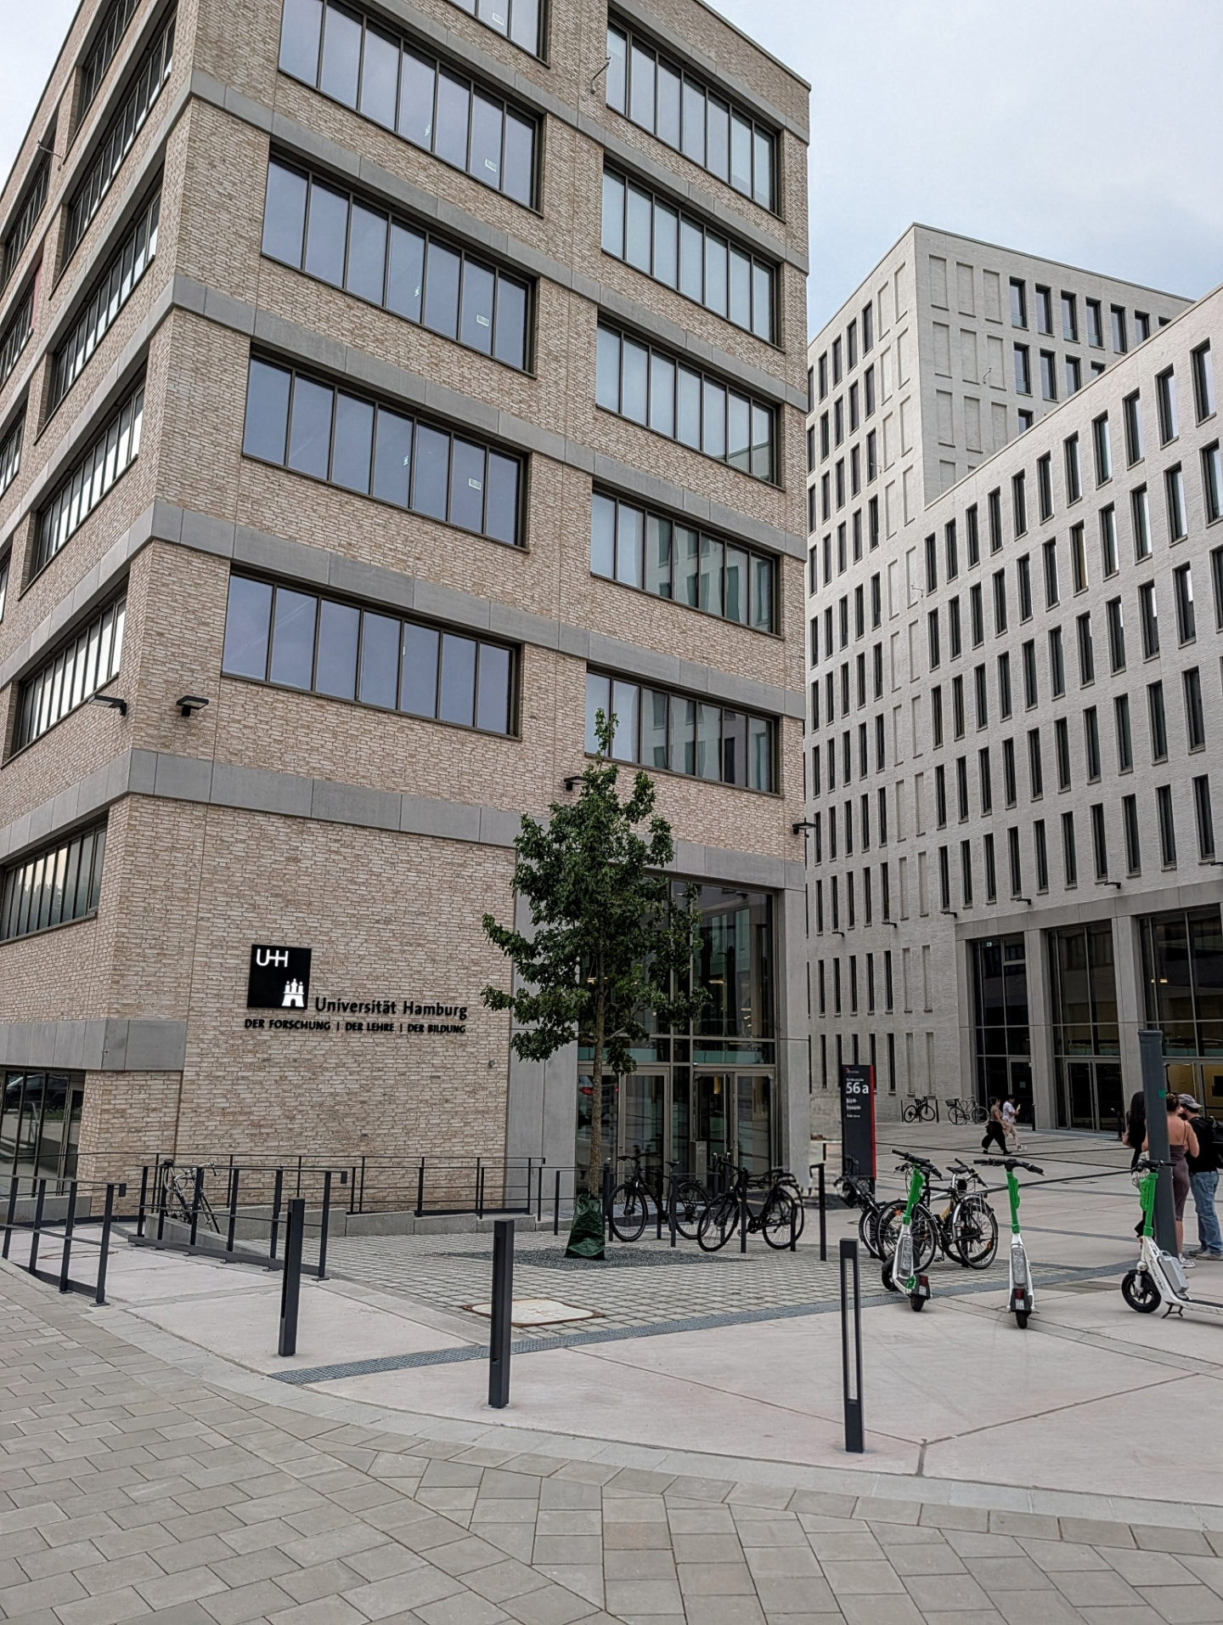
How do Modules at Informatik work?
Research Groups (Led by Professors)
They offer „Modules“
Can be:
  Courses (lectures + seminars or exercises)
  Seminar (3-credit standalone module)
  Master Project
  Hackathon
  Internship (Praktikum)
  Theses
All of these courses can be found in the research groups page (https://www.inf.uni-hamburg.de/en/inst/groups.html) or in the STINE Course Catalogue

Slide 15
How do Modules at Informatik work?
Not all courses are available to everyone
Not all new courses are immediately available to IAS
STiNE explains which study branch can register which courses
It is still possible to add new courses to the IAS curriculum (happened two years ago with Optimization for ML)
Bio-inspired AI
Research Methods
Software Architecture
Intelligent Robotics
Focus Option
Neural Networks
Machine Learning
Focus Option
Focus Option
Extension Option
Project
Focus Option
Extension Option
Extension Option
Thesis

Slide 16
Agenda
Introduction
How do Modules at Informatik work?
Courses
If I had known…

Slide 17
Agenda
Introduction
How do Modules at Informatik work?
Courses
If I had known…

Slide 18
Bio-inspired AI
Research Methods
Software Architecture
Intelligent Robotics
Focus Option
Neural Networks
Machine Learning
Focus Option
Focus Option
Extension Option
Project
Focus Option
Extension Option
Extension Option
Thesis

Slide 19
Mandatory Courses
Bio-inspired AI
Research Methods
Software Architecture
Intelligent Robotics
Focus Option
Neural Networks
Machine Learning
Focus Option
Focus Option
Extension Option
Project
Focus Option
Extension Option
Extension Option
Thesis

Slide 20
Mandatory Courses
Focus Options
Bio-inspired AI
Research Methods
Software Architecture
Intelligent Robotics
Focus Option
Neural Networks
Machine Learning
Focus Option
Focus Option
Extension Option
Project
Focus Option
Extension Option
Extension Option
Thesis

Slide 21

Mandatory Courses
The course description is harder than the exam
Focus Options
Electives
Might need to actually show up once or twice… maybe.
Bio-inspired AI
Research Methods
Software Architecture
Intelligent Robotics
Focus Option
Coffee required. Sleep optional.
Neural Networks
Machine Learning
Focus Option
Focus Option
Extension Option
You don’t pass this course. You survive it
Project
Focus Option
Extension Option
Extension Option
Legend says the exam is written in blood
Thesis

Slide 22
Mandatory Courses
Bio-inspired Artificial intelligence
Lecture: Pof. Dr. Stefan Wermter | Seminar: Dennis Becker + WTM Group
Focus Options
Electives
Bio-inspired AI
Research Methods
Software Architecture
Intelligent Robotics
Focus Option
6 ECTS
Neural Networks
Machine Learning
Focus Option
Focus Option
Extension Option
The course has „Artificial intelligence“ in it. But most of the content is Neural Networks
"Bio-inspired" = links between neural architecture and human brain functions.
Strong overlap with Neural Networks and Knowledge Processing courses.
Project
Focus Option
Extension Option
Extension Option
Thesis

Slide 23
Mandatory Courses
Research Methods
Lecture: Dr. Sven Magg | Exercises: Sven Magg + Lennart Bengtson
Focus Options
Electives
Bio-inspired AI
Research Methods
Software Architecture
Intelligent Robotics
Focus Option
6 ECTS
Neural Networks
Machine Learning
Focus Option
Focus Option
Extension Option
One of the best course options in IAS
Sven is just awesome. You will attend lectures just because you love the lecturer
Course is a good mix of statistics, research and programming
Challenging but very rewarding course
Project
Focus Option
Extension Option
Extension Option
Thesis

Slide 24
Mandatory Courses
Software Architecture
Lecture: Prof. Dr. Linghui Luo | Seminar: Leif Bonorden + Dr. Jan Christian Dammann
Focus Options
Electives
Bio-inspired AI
Research Methods
Software Architecture
Intelligent Robotics
Focus Option
? ? ? ? ?
6 ECTS
Neural Networks
Machine Learning
Focus Option
Focus Option
Extension Option
Super easy for people who did software architecture, patterns in Bachelor. Super hard for people with AI/Math background but no software engineering background
Not sure why this course is mandatory for IAS
This year the new Professor teaches the course
Project
Focus Option
Extension Option
Extension Option
Thesis

Slide 25
Mandatory Courses
Intelligent Robotics
Lecture: Niklas Fiedler | Seminar: Niklas Fiedler + Jasper Güldenstein + Sam Liu
Focus Options
Electives
Bio-inspired AI
Research Methods
Software Architecture
Intelligent Robotics
Focus Option
6 ECTS
Neural Networks
Machine Learning
Focus Option
Focus Option
Extension Option
Probably the strictest seminar
It‘s recommended to take the course „introduction to robotics“ before starting this one. But it‘s also totally ok to start with IR
Project
Focus Option
Extension Option
Extension Option
Thesis

Slide 26
Mandatory Courses
Neural Networks
Lecture: Prof. Dr. Stefan Wermter | Seminar: WTM Group
Focus Options
Electives
Bio-inspired AI
Research Methods
Software Architecture
Intelligent Robotics
Focus Option
6 ECTS
Neural Networks
Machine Learning
Focus Option
Focus Option
Extension Option
History of NNs with good introduction to newer architectures such as transformers
Not only done by Prof. Wermter but also by different members of the WTM group
One of the very good lecturers that are invited by Prof. Wermter are Jae Lee (Transformers) and Hassan Ali (Gaze Prediction)
Project
Focus Option
Extension Option
Extension Option
Thesis

Slide 27
Mandatory Courses
Machine Learning
Lecture: Prof. Dr. Sören Laue | Exercises: Alhassan Abdelhalim + Hanna Herasimchyk + Robin Labryga
Focus Options
Electives
Bio-inspired AI
Research Methods
Software Architecture
Intelligent Robotics
Focus Option
9 ECTS
Neural Networks
Machine Learning
Focus Option
Focus Option
Extension Option
The most demanding yet most rewarding IAS course
Divided into 4 parts: Regression, supervised learning, unsupervised learning and Neural Networks
Sören explains exceptionally good. The exercises and the quizzes complement the lectures and are exam-relevant
You will feel you have really learned something
Project
Focus Option
Extension Option
Extension Option
Thesis

Slide 28
Mandatory Courses
Project
Focus Options
Electives
Bio-inspired AI
Research Methods
Software Architecture
Intelligent Robotics
Focus Option
12 ECTS
Neural Networks
Machine Learning
Focus Option
Focus Option
Extension Option
Can last 1 semester or 2 semesters
In small or large groups, depending on the projects
Some of the projects are really popular. Some are not
Can be registered in the winter semester or the summer semester
There are more projects in the summer semester than in the winter semester
Project
Focus Option
Extension Option
Extension Option
Thesis

Slide 29
Mandatory Courses
Master Thesis
Focus Options
Electives
Bio-inspired AI
Research Methods
Software Architecture
Intelligent Robotics
Focus Option
30 ECTS
Neural Networks
Machine Learning
Focus Option
Focus Option
Extension Option
Last 6 months from your date of registration
Prequisite: already completed 72 ECTS
Can register at ANY TIME. Not necessarily at the beginning of the semester
Can submit your thesis at ANY TIME after registration. Not necessarily to wait for your submission deadline
Project
Focus Option
Extension Option
Extension Option
Thesis

Slide 30
Knowledge Processing
Lecture: Dr. Matthias Kerzel | Exercises: Dr. Cornelius Weber
Computer Vision 1
Lecture: Prof. Dr. Simone Frintrop | Exercises: Emre Gülsoylu
6 ECTS
Trustworthy Artificial Intelligence
Lecture: Prof. Dr. Anne Lauscher | Exercises: Pranav Agrawal
6 ECTS
Optimization for Machine Learning
Lecture: Prof. Dr. Sören Laue | Exercises: Hanna Herasimchyk
6 ECTS
User Interface Software and Technology
Lecture: Prof. Dr. Frank Steinicke | Exercises: Dr. Sebastian Rings
6 ECTS
6 ECTS

Slide 31
Statistical Methods of Language Technology
Lecture: Prof. Dr. Chris Biemann | Exercises: Saba Anwar + Xintong Wang
Computer Vision 2
Lecture: Prof. Dr. Simone Frintrop | Exercises: Emre Gülsoylu
Database and Information Systems
Lecture: Dr. Annett Ungethüm | Exercises: …
6 ECTS
6 ECTS
9 ECTS
Pervasive Computing
Lecture: Prof. Dr Janick Edinger | Seminar: Lennart Bengtson
Speech Signal Processing
Lecture: Prof. Dr. Timo Gerkmann | Exercises: ….
Robot Technology
Lecture: Jasper + Niklas | Exercises: TAMS
6 ECTS
6 ECTS
6 ECTS

Slide 32
Independent Study
3 or 6 credits (Either in Focus option or extension option)
Not registered in STiNE. Has a special registariton procedure
Can have up to 6 credits in Focus option. 9 in Total
Can be done in ANY RESEARCH GROUP
Must be approved by the IAS committee

Slide 33
Extension Options
Need 15 credits in total
Can be:
  regular courses (Other Informatics courses or CISPA courses)
  (Technically, you can take whatever you want and argue why it makes sense to register it. Then it‘s up to the student office to decide if you can register)
  University-specific courses (Public lectures,… etc)
  Language classes
Notes:
https://www.uni-hamburg.de/allgemeinsprachen/ueber-uns/flyer-semester-winter-2025-26.pdf

Slide 34
Extension Options
Need 15 credits in total
Can be:
  regular courses (Other Informatics courses or CISPA courses)
  (Technically, you can take whatever you want and argue why it makes sense to register it. Then it‘s up to the student office to decide if you can register)
  University-specific courses (Public lectures,… etc)
  Language classes

Slide 35
Language classes
Algemeinesprache (Hamburger VHS)
Language Center (Sprachzentrum)
To easily find them, google “DAF A1 A2 Uni Hamburg”
Offers German classes from A1 till A2
Offers 13 other language classes from A1 to B
You get Credits!
Can’t register from STiNE.
You register in their website, do the course and obtain a certificate after passing the course. You send it to the student office to get credits
Check their registration window. Places are limited!
Registration starts from October 9
To easily find them, google “DAF Uni Hamburg”
Offers German classes from B1 till C1
Offers 8 other language classes.
You get Credits!
You DO register in STiNE.
That means you get your schedule, your notes and everything in STiNE
Registration times are the same as STiNE
Meaning if you have already prior knowledge and want to start with B1 or higher, You can still register by tomorrow!
Notes:
https://www.uni-hamburg.de/allgemeinsprachen/ueber-uns/flyer-semester-winter-2025-26.pdf

Slide 36
Agenda
Introduction
How do Modules at Informatik work?
Courses
If I had known…

Slide 37
Agenda
Introduction
How do Modules at Informatik work?
Courses
If I had known…

Slide 38
If I had known…
You do NOT need to finish exactly in 2 years
If your goal is to stay in Germany, learning German is a MUST so don’t stop even you fulfill the credits. Take more language classes if you can
You can do an internship in companies as a student. It’s worth it!
Think also about doing a semester abroad. You can and you will get credits
Notes:
https://www.uni-hamburg.de/allgemeinsprachen/ueber-uns/flyer-semester-winter-2025-26.pdf

Slide 39
Questions?
“I like dumb questions.”
- Alhassan Abdelhalim
Do you hate asking questions in public? 👉👈
Then email me gladly!
alhassan.abdelhalim@uni-hamburg.de
Or visit!
10-755 at Bu56b

